Slide 1
Learning Objectives
to calculate the index of refraction
To understand the phenomenon of total internal reflection

Slide 2
The Index of Refraction
The ratio of the speed of light in a vacuum to the speed of light in that medium.
Formula:
n is the index of refraction
c is the speed of light a vacuum (3.00x10⁸ m/s)
v is the speed of light in a given medium.

Slide 3
C
n
v

Slide 4
Another way to determine Index of Refraction
(In a vacuum)
(In a medium)

Slide 5
Example 1: Calculate the speed of light in diamond.
Note: n_{diamond}= 2.42 (from table 1 on p. 524)
1.24 x 10⁸ m/s

Slide 6
Example 2: The speed of light in water is 2.25x10⁸ m/s. Determine the index of refraction.
n = 1.33

Slide 7
Example 3: Calculate the speed of light in olive oil. N_{olive} _{oil} = 1.48
2.03 x 10⁸ m/s

Slide 8
12.5 Total Internal Reflection

Slide 9
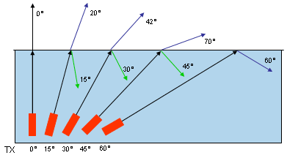
Total Internal Reflection
Light bends away from the normal when it speeds up at a boundary of two media.
As the angle of incidence increases, the angle of refraction will also increase.

Slide 10
Total Internal Reflection
The critical angle is the angle of incidence which gives an angle of refraction of 90º.
If you increase the angle of incidence past the critical angle, the refracted ray no longer exits the medium. This is called total internal reflection.

Slide 11
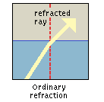
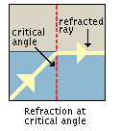
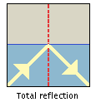
Total Internal Reflection

Slide 12
Total Internal Reflection

Slide 13
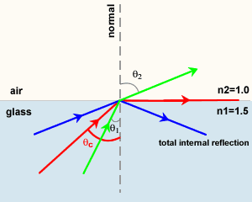

Slide 14
Conditions for Total Internal Reflection
Light is travelling more slowly in the first medium than in the second.
The angle of incidence is greater than the critical angle (no refraction occurs; all light is reflected back into the medium)

Slide 15
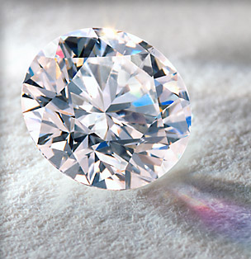
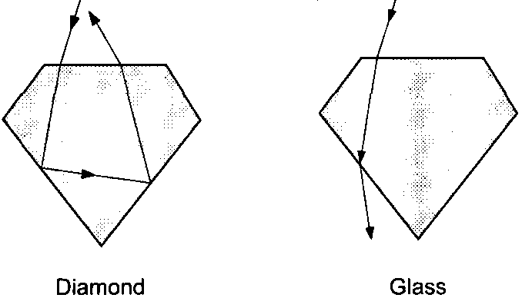
Applications / Examples of Total Internal Reflection
Diamonds

Slide 16
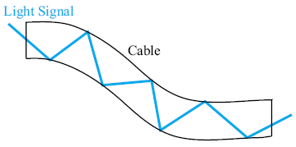
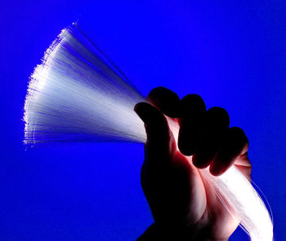
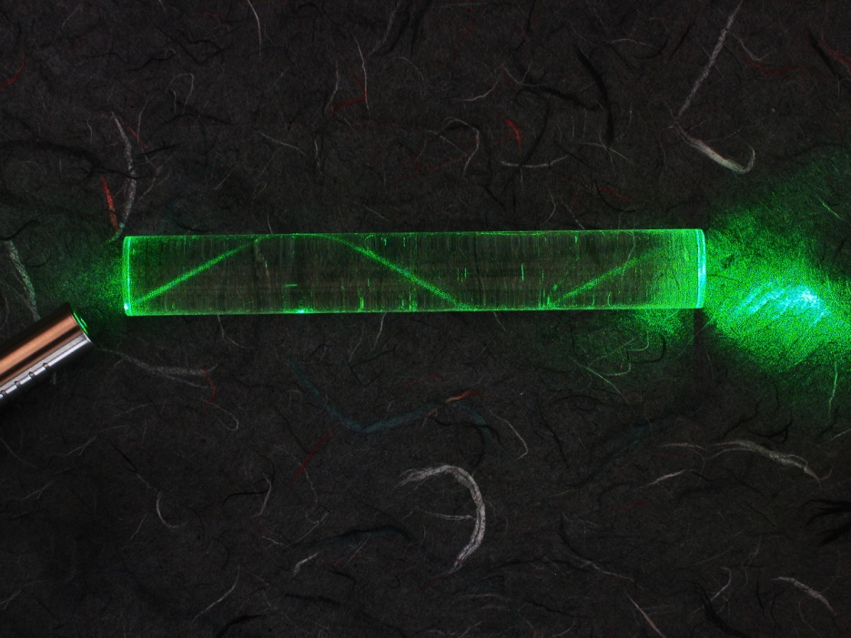
Fibre Optics

Slide 17
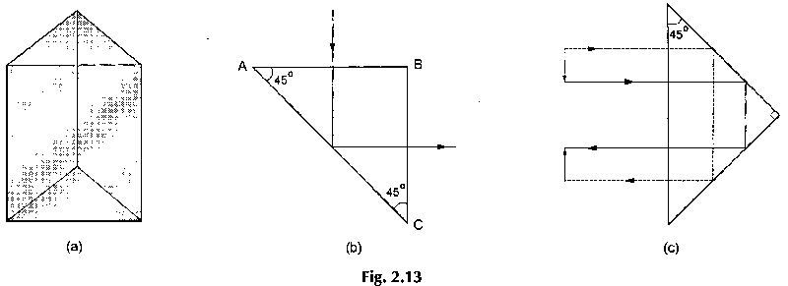
Triangular Prisms
Exhibit total internal reflection.
Reflect almost 100% of light internally.

Slide 18
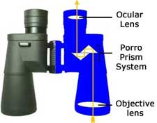
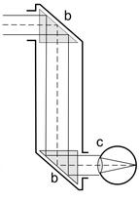
Applications of triangular prisms
Binoculars
Periscopes

Slide 19
Retro-reflectors
A retro-reflector is an optical device in which the emergent ray is parallel to the incident ray.
i.e. they reflect light back the way it came.
Occurs as a result of two total internal reflections.
Applications of retro-reflectors include…

Slide 20
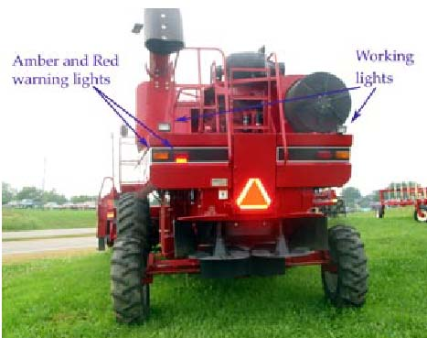
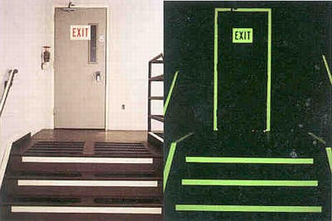
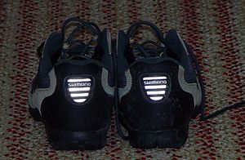
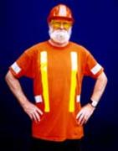

Slide 21
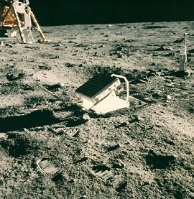
LR³
An array of retro-reflectors placed on the moon.
Used to accurately determine the distance to the moon

Slide 22
Reflect on this:
P. 525 # 1 - 9
P. 531 # 1 - 5, 8
Refraction Practice worksheet

