Slide 1
SNC2D
To discuss and appreciate the intricacies of the musculoskeletal system!

Slide 2
The Musculoskeletal System
It will really move you!

Slide 3
What do you think a human skeleton looks like?
Using the template provided, draw / sketch the major bones of the human skeleton.

Slide 4
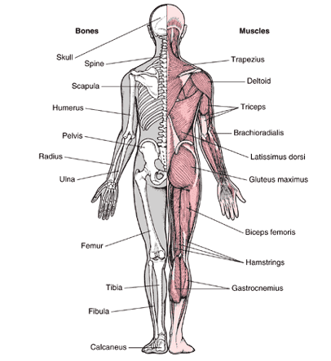
Function
Structure and support
Movement
Protection of internal organs
Storage
Production of blood cells

Slide 5
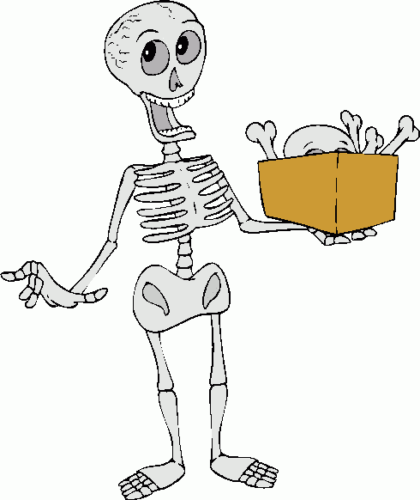
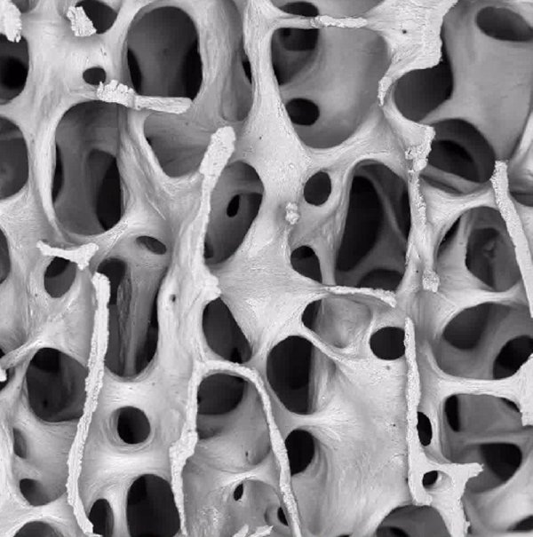
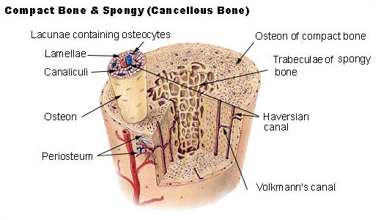
The Skeleton
3 types of connective tissue: bone, ligament, cartilage
Bones are hard and dense, and provide the strength to support the body

Slide 6
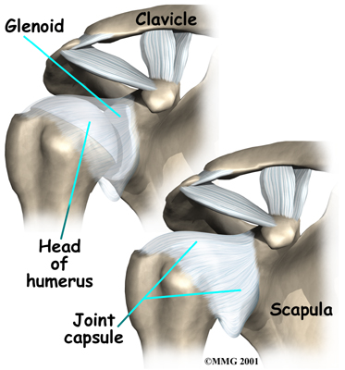
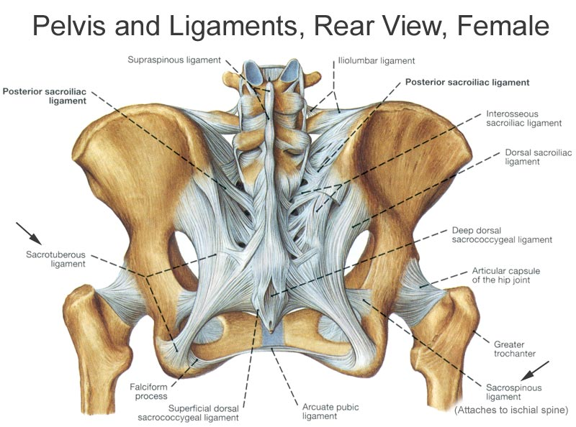
The Skeleton
Ligaments hold bones together and are made of protein

Slide 7
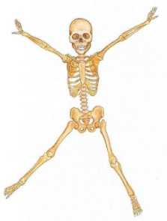
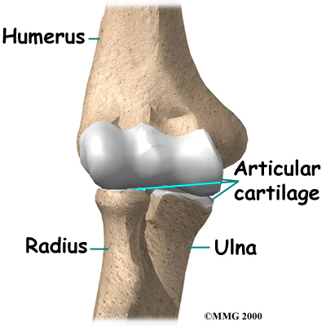
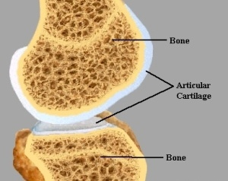
The Skeleton
Cartilage provides frictionless padding between bones and is strong and flexible

Slide 8
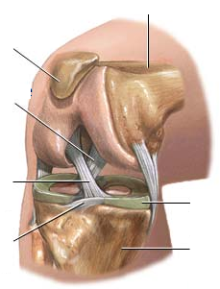
Femur (Thigh bone)
Patella (Kneecap)
Posterior Cruciate Ligament (PCL)
Anterior Cruciate Ligament (ACL)
Cartilage
Meniscus Ligament
Tibia (Shin bone)

Slide 9
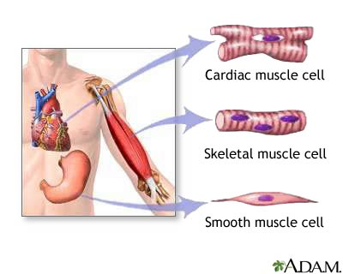
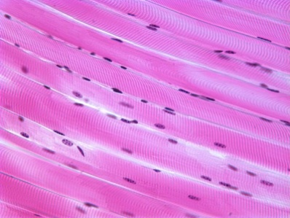
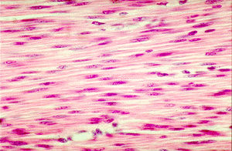
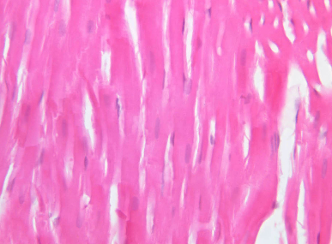
The Muscles
3 types: skeletal, smooth, and cardiac
Skeletal
Smooth
Cardiac

Slide 10
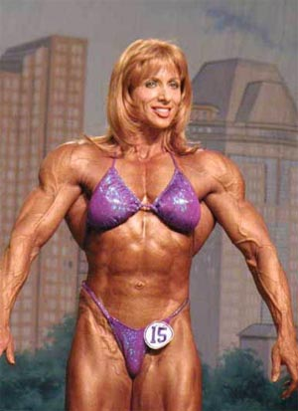
Skeletal Muscle
For voluntary movement
Contain many mitochondria
Also called striated
Unnatural
Natural

Slide 11
Smooth Muscle
Found in internal organs
involuntary

Slide 12
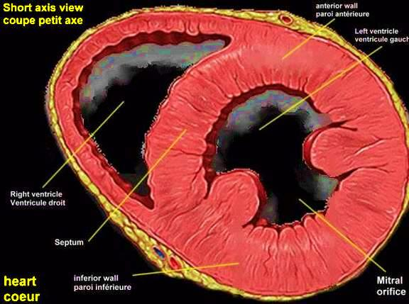
Cardiac Muscle
Found only in the heart
Also involuntary

Slide 13
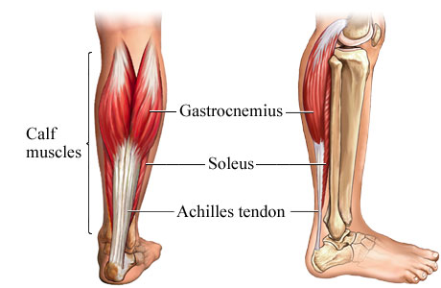
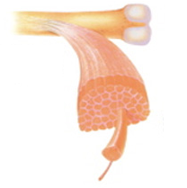
The Muscles
Found in bundles
Attached to bone by tendons

Slide 14
The Skeleton and The Muscles
Skeletal muscles work in opposing pairs or groups
A contraction is a shortening of one (set of) muscle and the lengthening of the opposing (set of) muscle
Muscles are able to pull, but not push

Slide 15
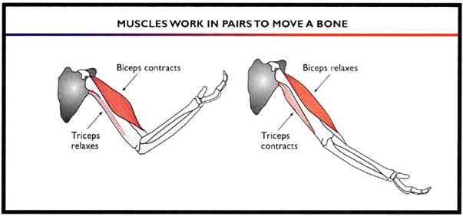

Slide 16
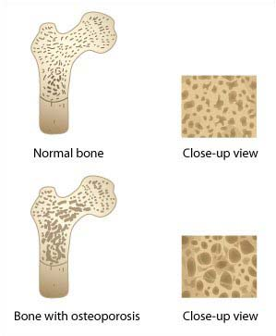
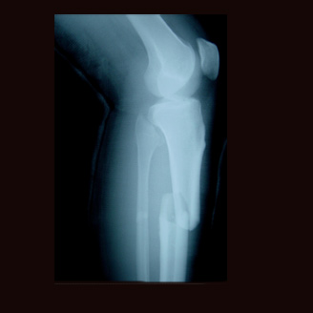
Problems associated with the Musculoskeletal System
Osteoporosis (loss of bone density)
Fractures, sprains, tears, muscle wasting

Slide 17
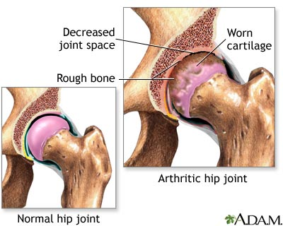
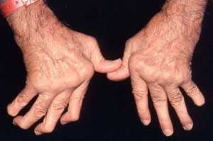
Problems associated with the Musculoskeletal System
Arthritis

Slide 18
Muscle Fatigue Activities
5 Stations
1. Get a grip (popsicle stick / paperclip
2. Clothespin calesthenics
3. To beat or Not to beat (tennis ball)
4. Too tired to sit (wall sit)
5. Weight lifting (textbook)

Slide 19
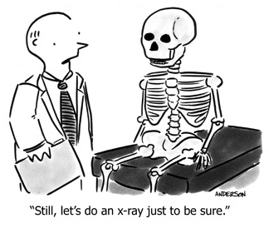
To do:
Page 101 # 1 – 6
Unit Test
Chapter 2 & 3
Next week!

