Slide 1
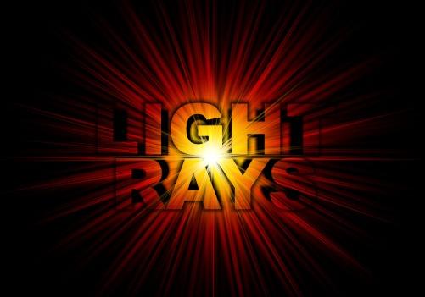
Learning Objectives –
To learn the terminology of the ray model of light
To discover the laws of reflection in plane mirrors

Slide 2
The Ray Model of Light
Section 11.4

Slide 3
Terminology
Light Ray: a line and arrow representing the direction and path of light
Geometric Optics: the use of light rays to determine how light behaves after striking an object
Light has three options:
It can be absorbed by the object
It can pass through the object
It can be reflected by the object
In any combination

Slide 4
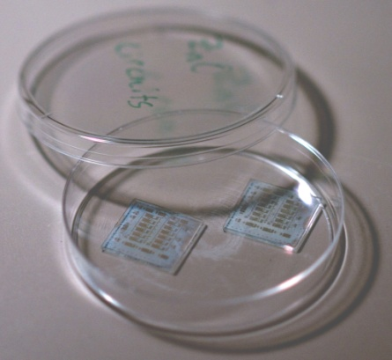
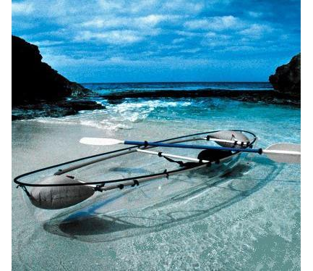
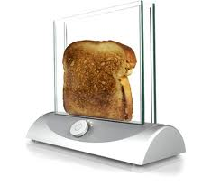
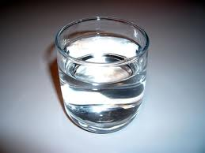
Terminology
Transparent objects allow all / almost all the light to pass through easily

Slide 5
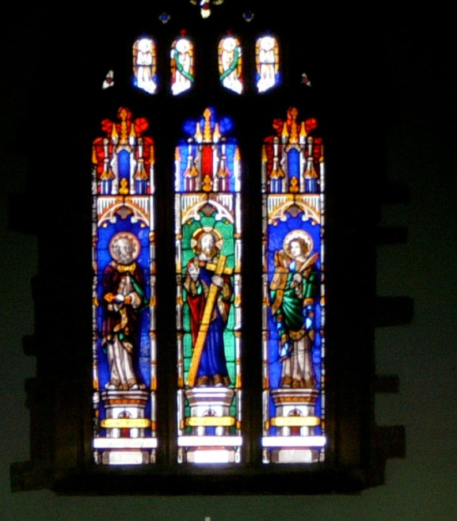
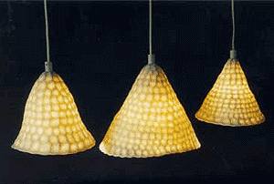
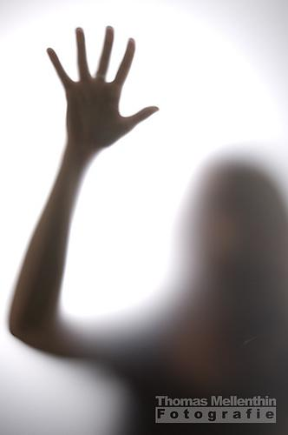
Terminology
Translucent objects allows some light to pass through, but objects cannot be clearly seen behind the object

Slide 6
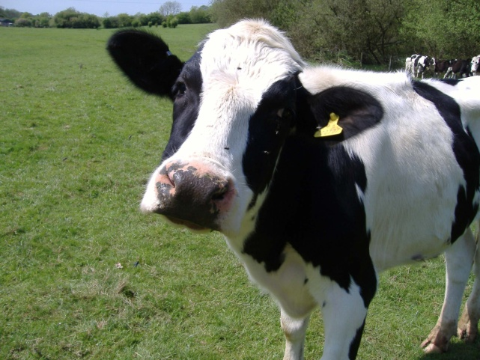
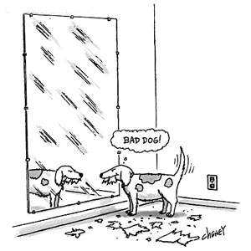
Terminology
Opaque objects either absorb or reflect all light

Slide 7
Terminology
Light emitted from a source and striking an object is called incident light
Light bouncing off an object is called reflected light
An image is a reproduction of an object that is produced through the use of light
Mirrors reflect most incident light

Slide 8
Reflect on this….
Using a ray box and a plane mirror, make as many observations as you can about the incident and reflected light.

Slide 9
Drawing Mirrors and Light Rays
Back of mirror
Point of Incidence
Reflective side of mirror
Angle of incidence < i
Angle of reflection < r
Incident ray
Reflected ray
Normal

Slide 10
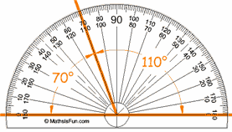
Using a Protractor
The zero line lies on the normal
This point is always on the vertex of the angle.

Slide 11
Using a Protractor

Slide 12
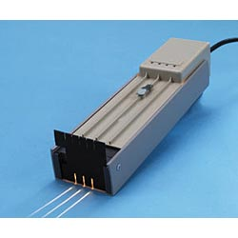
Reflecting Light off a Plane Mirror
Page 482 – 483
Observation Table [p.482 Table 1]
Analyze & Evaluate parts a – f
Answer questions #3 – 6 on page 481

