Slide 1
The Respiratory System

Slide 2
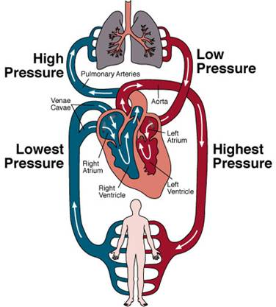
What is the Respiratory System?
Responsible for providing oxygen needed for the body, in exchange for carbon dioxide produced by cells as they carry out their daily functions.
The respiratory system relies on the circulatory system to distribute oxygen and remove carbon dioxide.

Slide 3
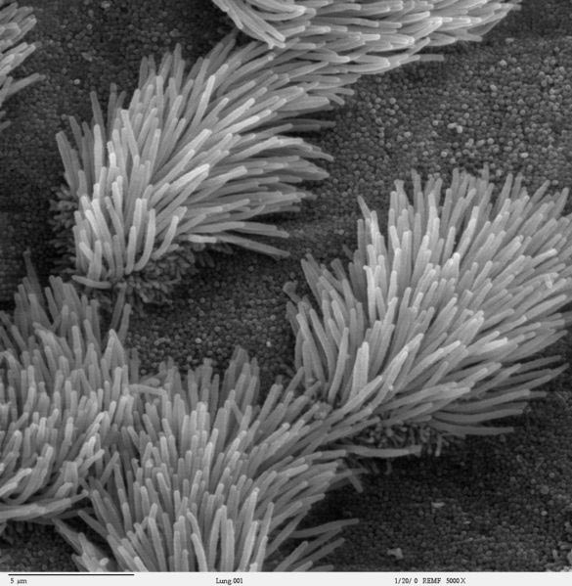
Special features include:
Epithelial cells needed to secrete mucous to warm and moisten the air.
Cilia needed to filter the
air of foreign particles.

Slide 4
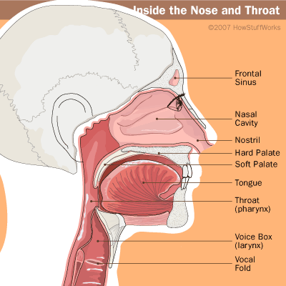
Parts of the Respiratory System
Nasal Cavity - mucous lining and cilia inside trap foreign particles.
Oral Cavity - secondary inhaler and exhaler, warms and moistens air.

Slide 5
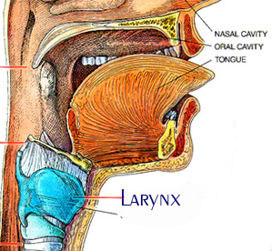
Larynx - The larynx has three main functions:
1) a passageway for air
2) a valve to close off the air (contains the epiglottis)
3) as a voice box

Slide 6
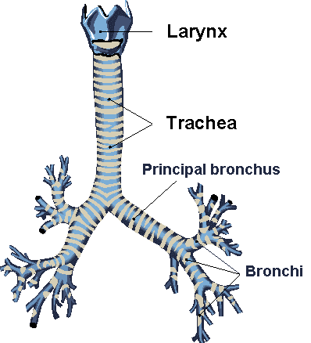
Pharynx (throat)- The pharynx is shared with the digestive system, it connects oral and nasal cavities.
Food goes on down the esophagus and air passes on through the trachea
Trachea (windpipe) - allows air to
pass beyond the larynx to
where it divides into the left and
right bronchi.
Contains rings of cartilage for protection.

Slide 7
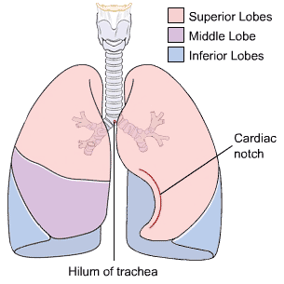
Lung - The main function of the
lungs is to exchange carbon
dioxide for oxygen and vice
versa.
Right bronchus - leading to the
right lung, warms and moistens air
Diaphragm - helps to expand and contract the lungs, forcing air into and out of them.

Slide 8
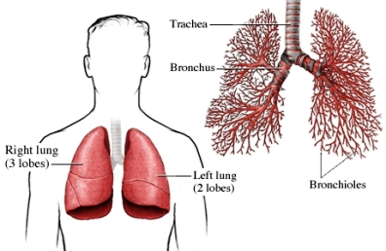
Left bronchus - has a sharper bend due to the presence of the heart and major blood vessels directly underneath it.
Bronchiole – smaller branches of bronchi, by the time the air has reached here from outside, it has been warmed up to body temperature, filtered and moisturized.

Slide 9
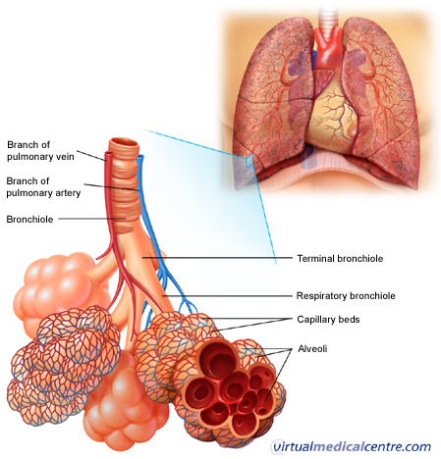
Alveoli - link between
the respiratory and circulatory systems,
they are lined with capillaries and gas exchange happens here.

